Slide 1
RESEARCH Project
Data Science Engineering Methods & Tools

Slide 2
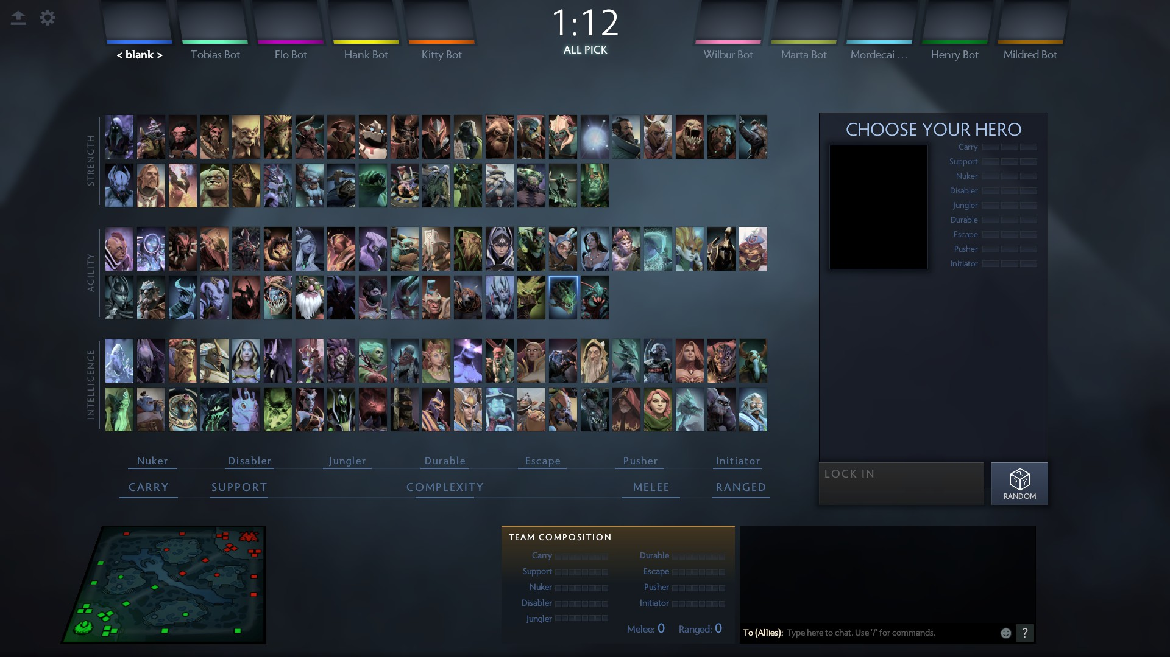
RESEARCH IDEA:
DOTA 2 is an online Moba (Multiplayer online battle arena) game that is played between 2 teams consisting of 5 players.
Each Player chooses from over 116 heroes. The main objective of the game is to destroy the enemy teams "Ancient".
This project will try to predict the winning team based on the draft (hero selection) before the game is actually played.

Slide 3
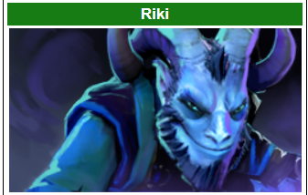
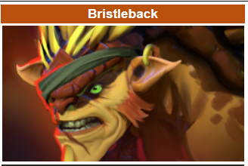
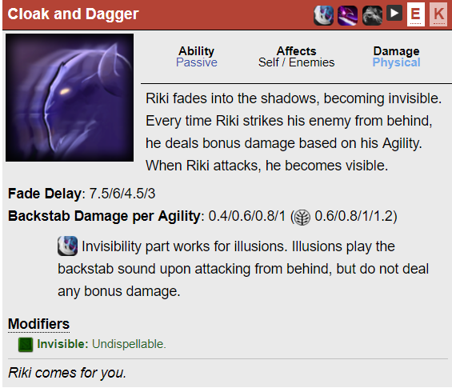
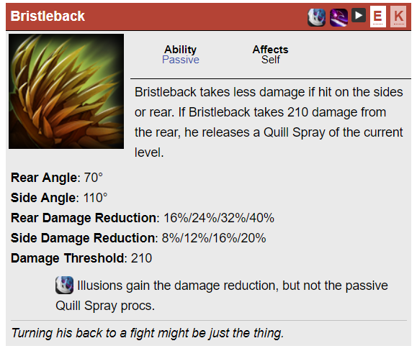

Slide 4
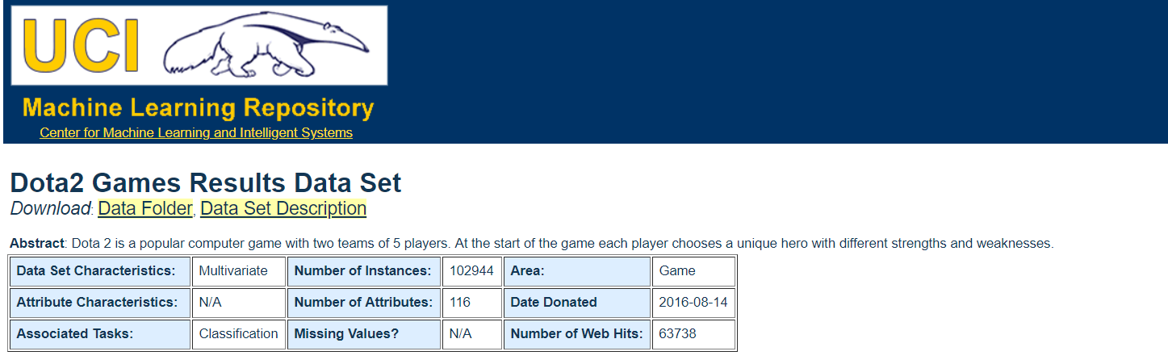
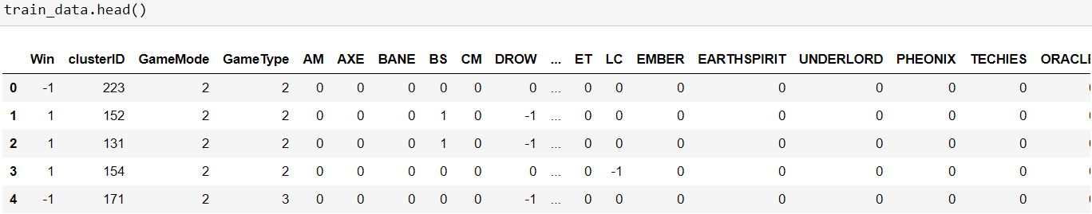
Dataset

Slide 5
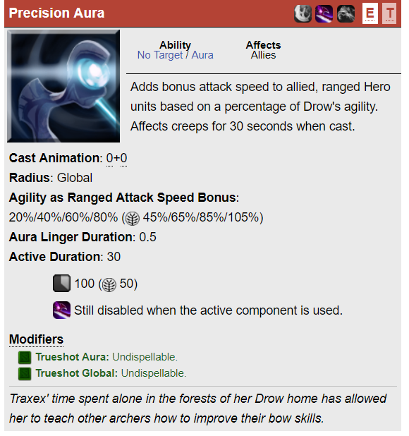
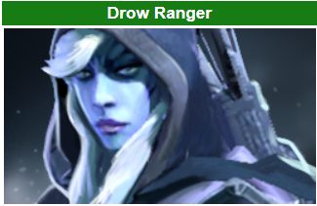
Feature Engineering:
Hero Win-rate
Hero Dire Win-rate
Hero Radiant Win-rate
Pick-rate * win-rate ?
Synergy matrix?

Slide 6
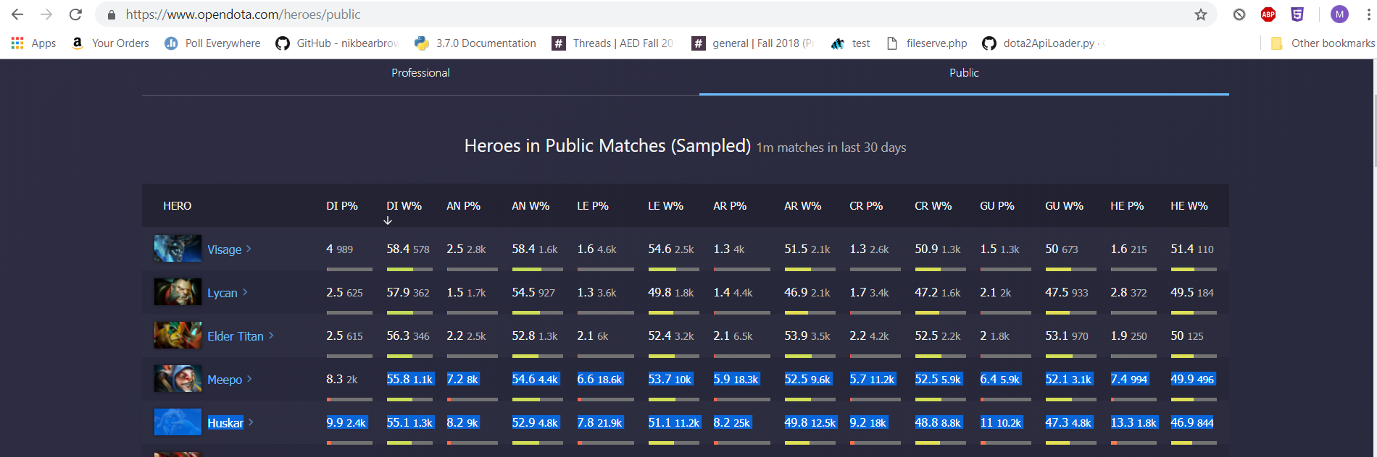
HERO WIN RATES BASED ON SKILL

Slide 7
Evaluate the success:
We get the data from UCI repository
We are using a dataset which has 100,000 matches in which 90,000 will be training on and 10,000 we will use for testing model using techniques like:
Multi – layer perceptron
Logistic regression
Support vector Machine
Random Forest
to find the best model for the dataset.

Slide 8
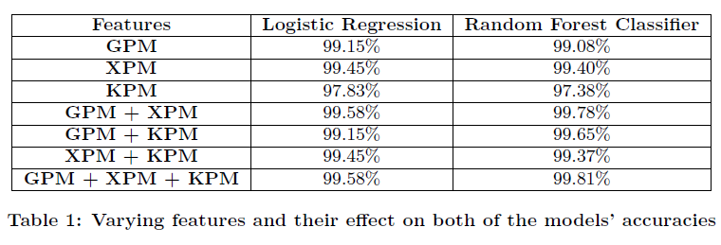
Background research
The Research paper predicts results on every minute during the game. Taken from: http://jmcauley.ucsd.edu/cse255/projects/fa15/018.pdf

Slide 9
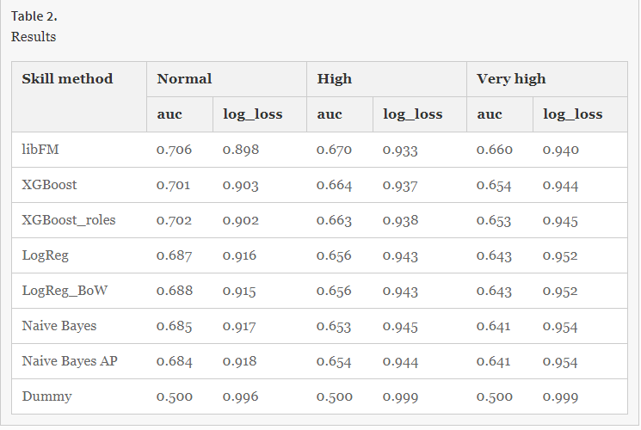
The Research paper uses skill as a feature. The dataset is taken from: https://link.springer.com/chapter/10.1007/978-3-319-52920-2_3#Sec10

Slide 10
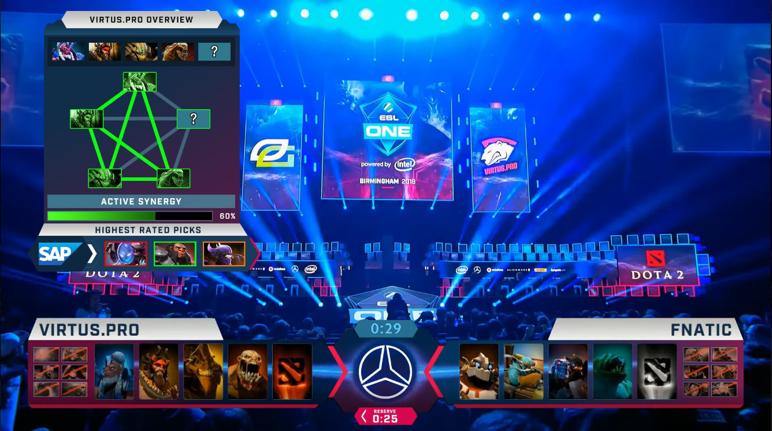
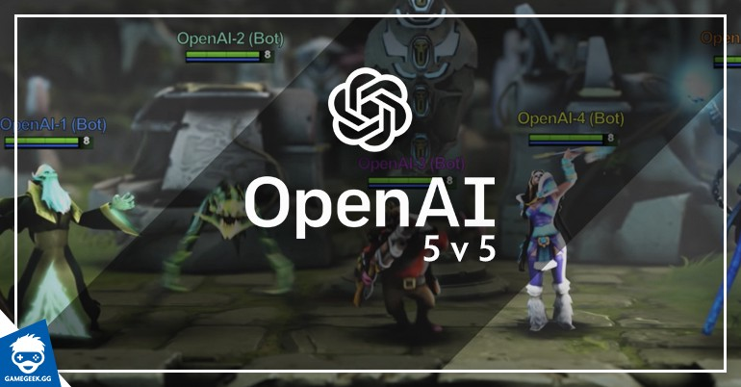

Slide 11
What we are going to do next?
Multi – layer perceptron
Logistic regression
Support vector Machine
Random Forest
Finding the set of features to predict the best model.

